Slide 1
Simulations & Curves
Mooney Rivlin & Polynomial

Slide 2
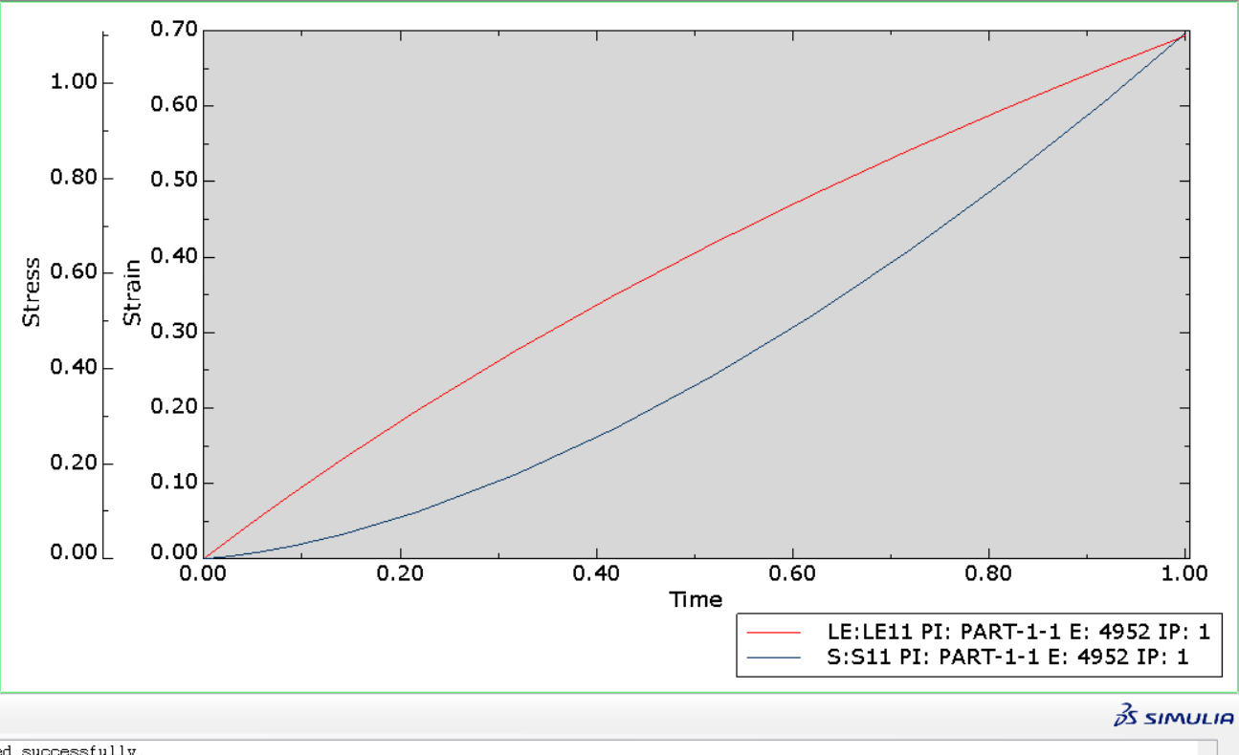
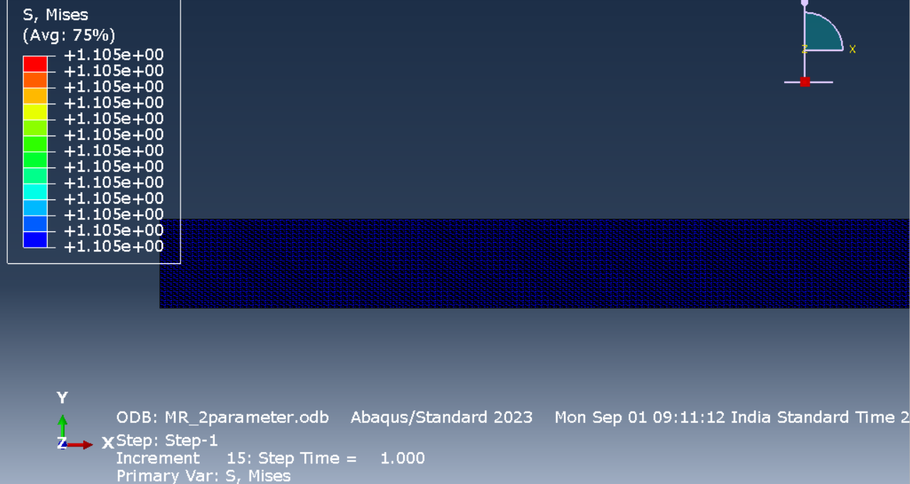
Mooney Rivlin – 2 parameters
Strain | Stress (MPa)
0 | 0
0.00995 | 0.001845
0.019803 | 0.003993
0.034401 | 0.007764
0.055908 | 0.014606
0.087324 | 0.027378
0.132672 | 0.051734
0.197056 | 0.098742
0.275973 | 0.177485
0.349115 | 0.27309
0.41727 | 0.383905
0.481075 | 0.508827
0.541052 | 0.6471
0.597634 | 0.798196
0.651185 | 0.96174
0.693147 | 1.10528
Setup: Plane stress, Triangular Mesh, Dimensions of block = 30mmX10mm, Displacement given = 30mm

Slide 3
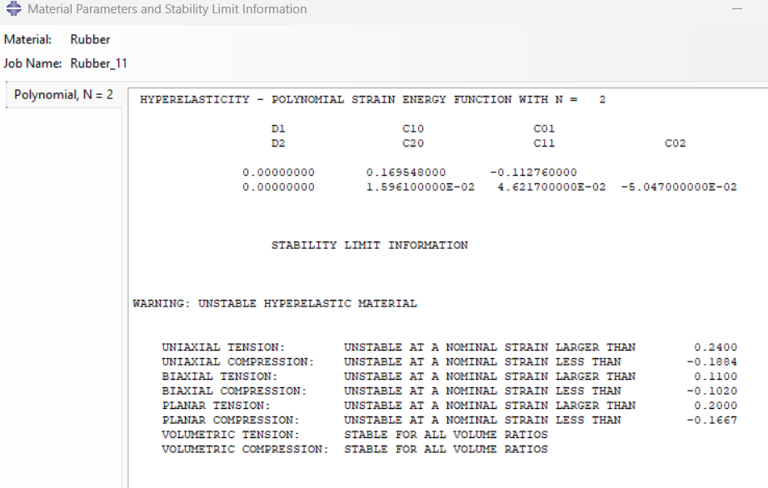
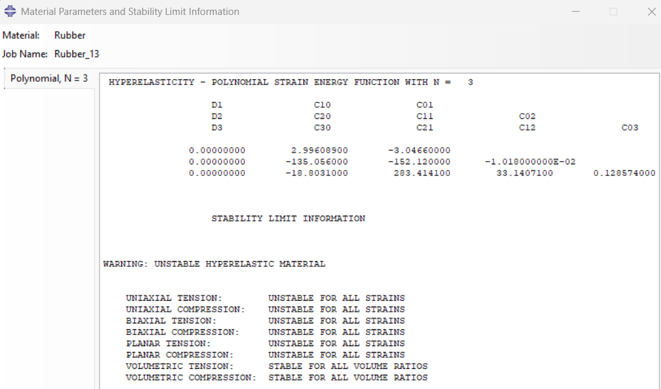
Polynomial – 5&9 parameters
The option for strain energy potential order other than one is unavailable under Mooney Rivlin in Abaqus. Hence, used the polynomial.

Slide 4
Polynomial – 5 parameters
Polynomial – 9 parameters
Strain | Stress
0 | 0
0.00995 | 0.001845
0.019803 | 0.003993
0.034401 | 0.007764
0.055908 | 0.014606
0.087324 | 0.027378
0.132672 | 0.051734
0.197056 | 0.098742
0.275973 | 0.177485
0.349115 | 0.27309
0.41727 | 0.383905
0.481075 | 0.508827
0.541052 | 0.6471
0.597634 | 0.798196
0.651185 | 0.96174
0.693147 | 1.10528
Strain | Stress
0 | 0
0.00995 | -0.01144
0.019803 | -0.07968
0.034401 | -0.41358
0.055908 | -1.78396
0.087324 | -6.79602
0.132672 | -23.3698
0.197056 | -71.4993
0.275973 | -165.413
0.349115 | -244.066
0.41727 | -212.909
0.481075 | 64.1655
0.541052 | 764.389
0.597634 | 2106.44
0.651185 | 4351.27
0.693147 | 7085.1
The same stress-strain values are obtained as for the 2-parameter Mooney Rivlin.

Slide 5
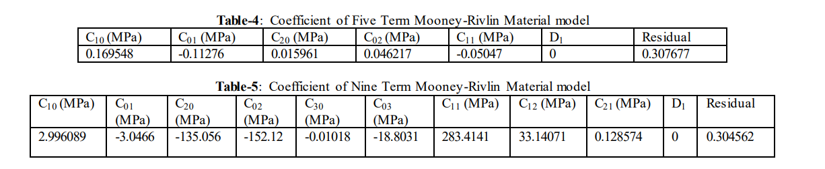
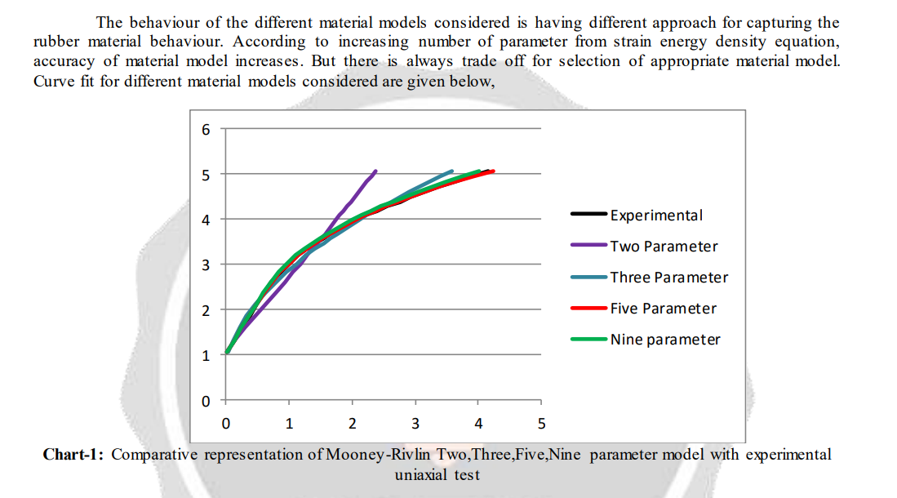
https://scispace.com/pdf/comparative-study-of-variation-of-mooney-rivlin-hyperelastic-3e97pfpngh.pdf
Notes:
Papers had:
Sugihardjo, Hidajat & Tavio, Tavio & Lesmana, Yudha. (2018). FE Model of Low Grade Rubber for Modeling Housing’s Low-Cost Rubber Base Isolators. Civil Engineering Journal. 4. 24. 10.28991/cej-030966. https://civilejournal.org/index.php/cej/article/view/613/pdf
https://abaqus.uclouvain.be/English/SIMACAEGSARefMap/simagsa-t-materialpropertieshyperelasticmodelfortherubber.htm

Slide 6
The mechanical behaviour of rubber under hydrostatic compression and the effect on the results of finite element analyses
Jan Zimmermann · Markus Stommel

Slide 7
Aim
1. Proving validity by determining the mechanical behaviour of NR under hydrostatic pressure.
Assumption: In FE simulations, a split of the strain energy function takes place, splitting stresses into a deviatoric and a volumetric part.
2. To determine the bulk modulus of Natural rubber and its effects on the simulation results of a bearing.
The obtained results are compared to test data to show the bulk modulus is an important material parameter to optimise the quality of the simulation results achieved by hyperelastic material models in finite element analyses
Introduction
Models applied to hyperelastic materials are :
Based on a strain energy density function, for example, Mooney-Rivlin, Ogden
Molecular-statistical approaches, for example, Arruda-Boyce, Kilian.
Usual assumptions taken:
Incompressible material behaviour
Setting the bulk modulus K to a constant value, which is several orders of magnitude higher than the applied shear modulus.
This offers a satisfactory outcome quality for most of the technical applications of rubber, since they are not dealing with higher hydrostatic pressure values up to several 100 bar.
However, a large deviation between simulation results and the components’ real-life behaviour of characteristics like material stiffness, dependent on the approximated bulk modulus, is obtained.

Slide 8
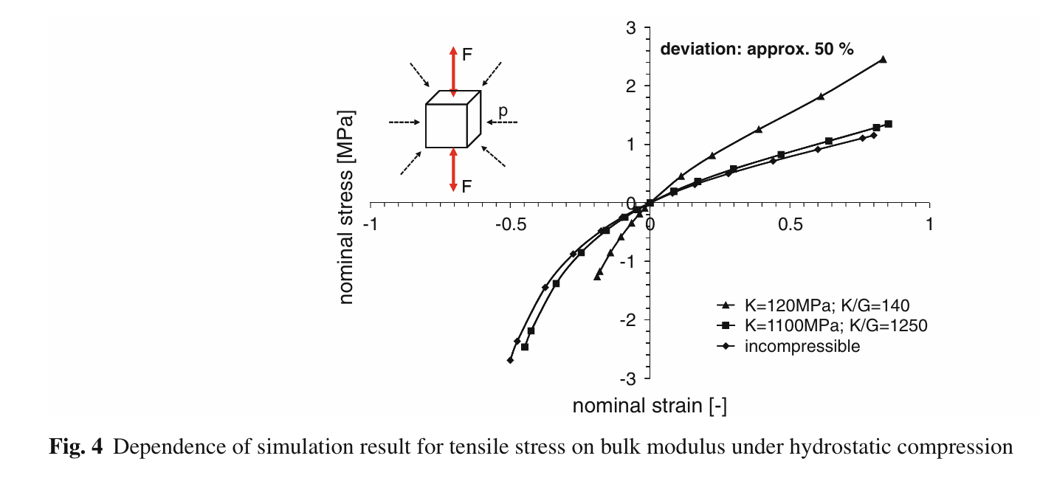
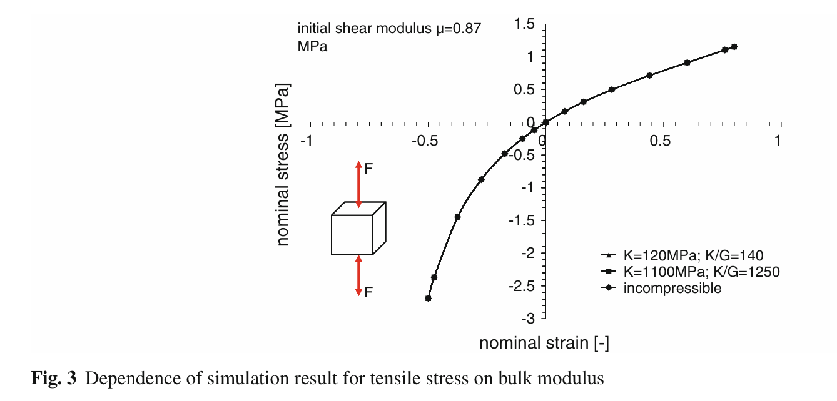
In Fig. 3, the simulation results of a unidirectional compression and tensile test for different values of the bulk modulus are compared to the results obtained by assuming incompressibility.
There is no significant deviation between the resulting stresses, and hence no dependence on the bulk modulus.
But when conducting the same simulation on specimens under hydrostatic pressure, the results deviate considerably, even though every chosen value of the bulk modulus fulfils the condition of being orders of magnitude higher than the shear modulus.
Fig. 4 shows the dependence of the nominal stress on the bulk modulus for a natural rubber in tensile and compression tests on a rubber component under a constant hydrostatic pressure of 300 bar.

Slide 9
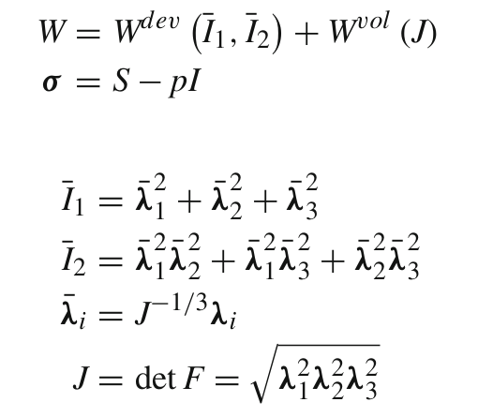
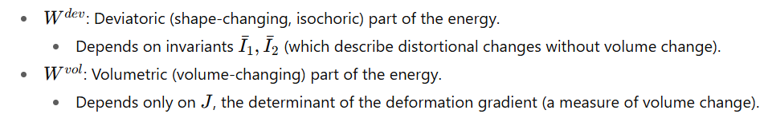
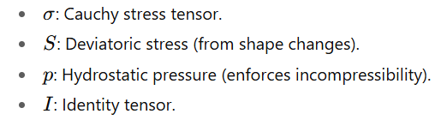
Assumption: Material models based on a strain energy density function assume a split of the respective function into two parts,
The deviatoric, incompressible deformation covers the isochoric change in shape due to the applied load.
The volume-changing deformation, dependent on the hydrostatic pressure.
In the present paper, the validity of these assumptions is examined.
Notes:
Deviatoric" comes from deviator, meaning the part of stress or strain that causes shape change without volume change
So isochoric deformation = deformation at constant volume.
In rubber mechanics, we often assume that rubber is nearly incompressible, so most of its deformation is isochoric

Slide 10
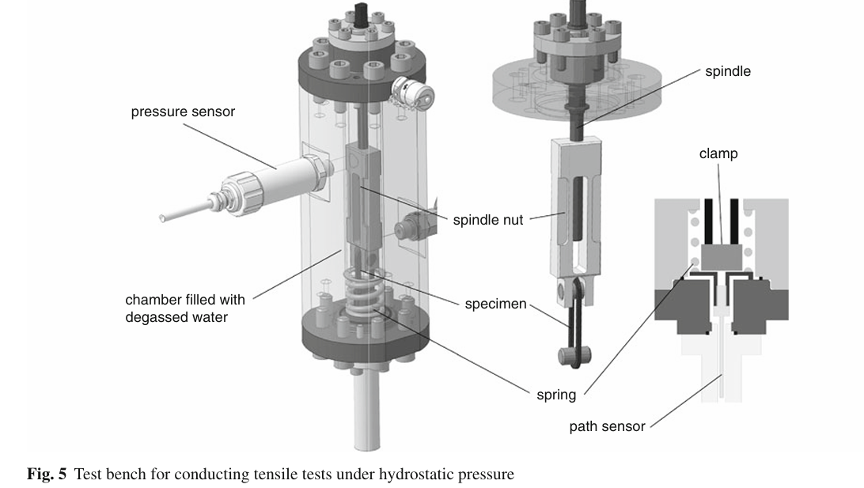
2. Test bench

Slide 11
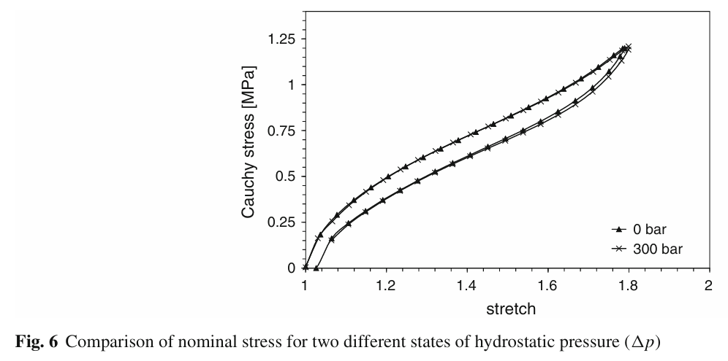
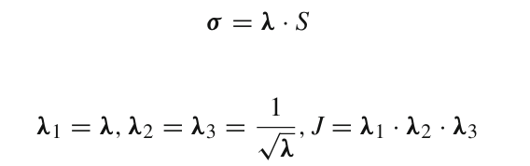
3. Results
The tests were conducted for a technical NR with a hardness of 56 Shore A.
Test specimens used: 2 mm thickness, cross-section area of 16 mm2.
Hydrostatic pressure values = 1, 100, 200, and 300 bar.
3.1 Tensile tests
Confirmed the assumption that there is no influence of hydrostatic pressure up to 300 bar on the deviatoric behaviour of an NR for stretches up to 80 %.
Since the influence of hydrostatic pressure has proved negligible, the split of the strain energy function is valid for the investigated NR.
This enables the determination of the Cauchy stress as follows:

Slide 12
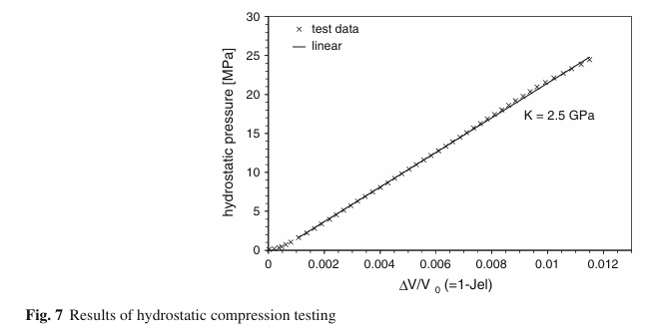
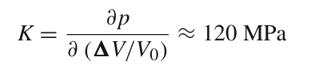
3.2 Hydrostatic compression tests
where λ1 = λ2 = λ3 < 1, in prev Cauchy stress calculation.
The specimen is cylindrically shaped with a length of 100 mm and 18 mm in diameter.
The bulk modulus of the tested rubber specimen corresponds to the slope of the displayed graph.
Due to the low pressure values, this results in an approximated bulk modulus, which corresponds to the initial value of the gradient, of
Several further tests using other types of rubber and shore hardness show the same effect:
a slight increase in curvature followed by a nearly linear relationship between volume change and hydrostatic pressure for higher volume ratios. There is an increase in the bulk modulus of about one order of magnitude.
Thus, the bulk modulus is an important feature to influence the outcome quality of FE simulations, especially for rubber components that are partially or completely exposed to hydrostatic pressure.

Slide 13
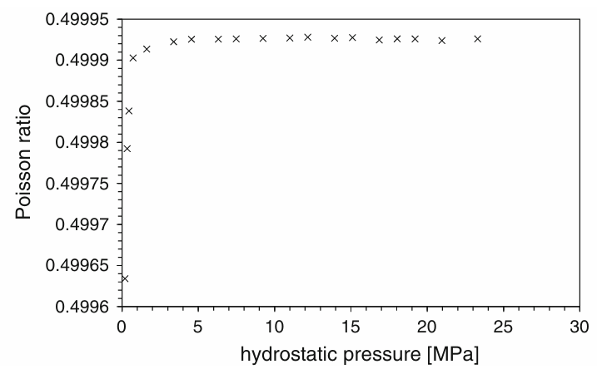
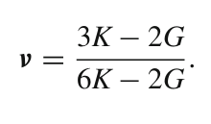
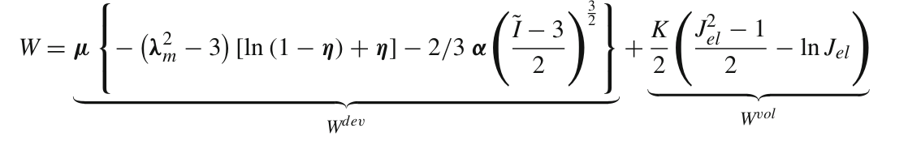
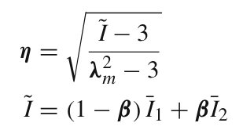
Since in the hydrostatic compression test only very small uniform strains occur, in contrast to mechanical tests (e.g., uniaxial tensile testing), the material behaviour under hydrostatic compression enables the approximation of the Poisson ratio (see Fig. 8) according to Krevelen as follows:
For hydrostatic pressure values greater than 4 MPa, the Poisson ratio is nearly constant at 0.49992, which again clearly indicates the compressibility of the rubber component.
3.3 Comparison of test results with FE simulations
μ =1.08(initial shear modulus);
λm = 5.92(locking stretch);
α = 0.18(global interaction parameter);
β = 0 (linear mixture parameter);
Ii = invariants of the Cauchy–Green tensor;
J = total volume change

Slide 14
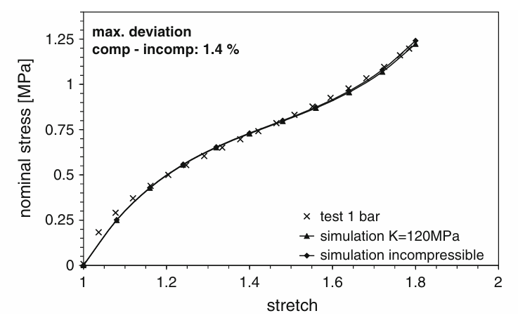
3.4 Comparison of tensile tests
A simple tensile test under normal pressure is simulated using two different settings.
At first, the rubber is assumed to be incompressible, which means the volumetric part of the strain energy function is neglected.
The second simulation is conducted with an assumed bulk modulus of 120 MPa.
As shown in Fig. 9, the deviation between the simulation results and the test data is negligible.
That means the assumption of incompressibility is valid, provided that the hydrostatic pressure values are sufficiently low. In this case, there is no significant influence of the bulk modulus on the tensile behaviour of these rubber components. The limitation of this assumption depends on the rubber used and its behaviour under hydrostatic compression.

Slide 15
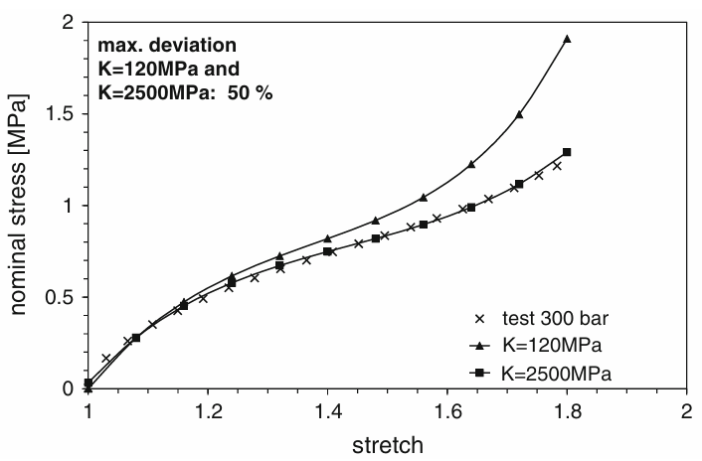
In a second step, according to the test conducted, simulations on a rubber component under a hydrostatic pressure of 300bar were carried out.
Viscoelastic effects are neglected in this comparison.
Instead of assuming an incompressible material behaviour, a bulk modulus of 2,500 MPa is chosen.
The results shown in Fig. 10 emphasise the importance of the knowledge of the exact volumetric behaviour of rubber in simulating rubber components exposed to higher hydrostatic pressure values.

Slide 16
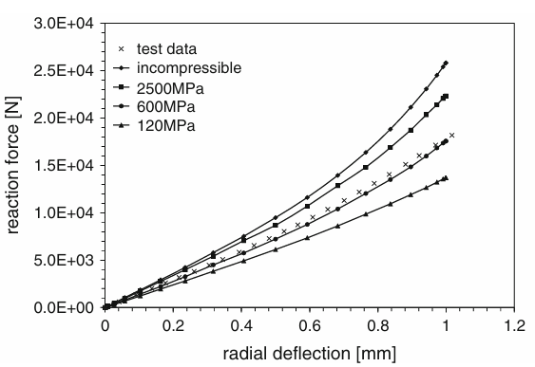
3.5 Influence on the simulation of confined rubber components
A bushing, as a practical rubber component, partially exposed to hydrostatic pressure up to 30 MPa, is used
This kind of bushing is used in automotive vehicles and significantly influences their road handling.
A crucial parameter is the material stiffness, which is determined in mechanical tests on the bushing under different load cases, such as radial or axial deflection, or torsion.
The material stiffness corresponds to the required reaction force to realise the radial deflection and serves as an indicator for the simulation outcome quality.
Notes:
A bushing is a cylindrical lining or component used in two main contexts: to reduce friction and wear between moving parts in mechanical systems, or to provide electrical insulation for a conductor passing through a conductive barrier. Mechanical bushings, also known as sleeve bearings, are typically made of low-friction materials like bronze or plastic, while electrical bushings are made of insulating materials such as porcelain or steatite.

Slide 17
Simulations & Curves
Mooney Rivlin with pressure applied

Slide 18
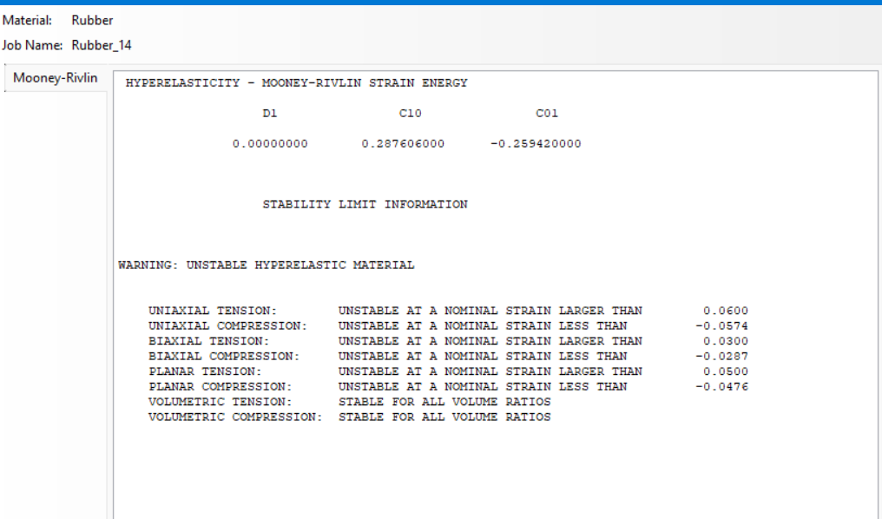

Slide 19
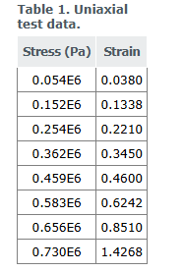
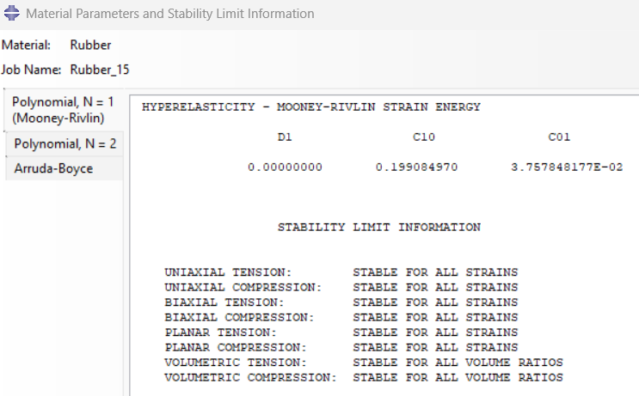

Slide 20
Run for less P values, 0.4 Mpa something with a quadratic mesh and inc increment steps
2. Apply rollers on top and bottom, fix the left side 1,2=0 & apply displacement on the right side – this will create the hydrostatic condition

